Slide 1
Computational Physics
(Lecture 1)
PHY4061

Slide 2
What is Computation?
Difference between computation and calculation?

Slide 3
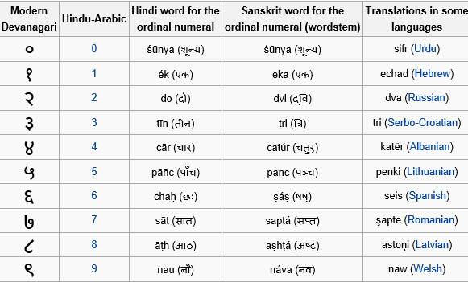
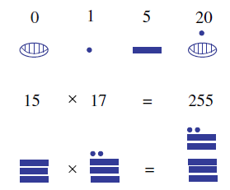
Early history of computation
From ancient times
Quantifying their knowledge and events
Number systems

Slide 4
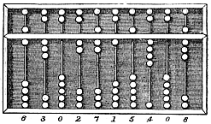
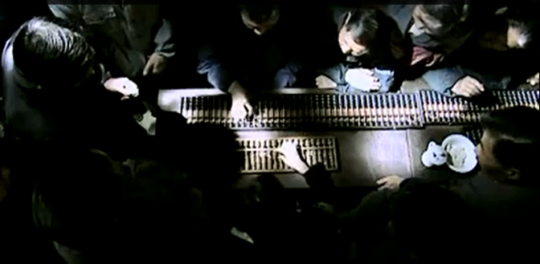
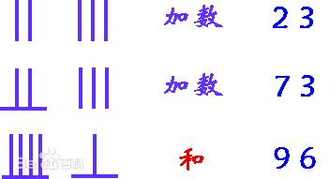
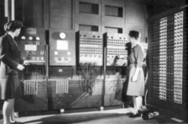
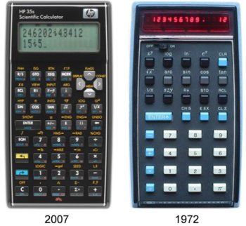
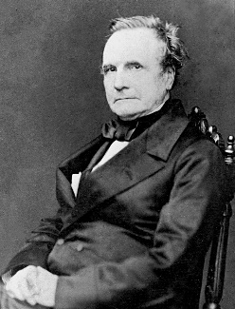
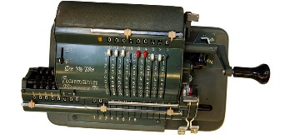
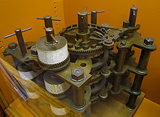
Historic tools in computation
Suanchou abacus
Mechanic computer
ENIAC(Electronic Numerical Integrator And Computer)
Calculators
Charles Babbage

Slide 5
Human Computer
The human computer is supposed to be following fixed rules; he has no authority to deviate from them in any detail." (Turing, 1950)

Slide 6
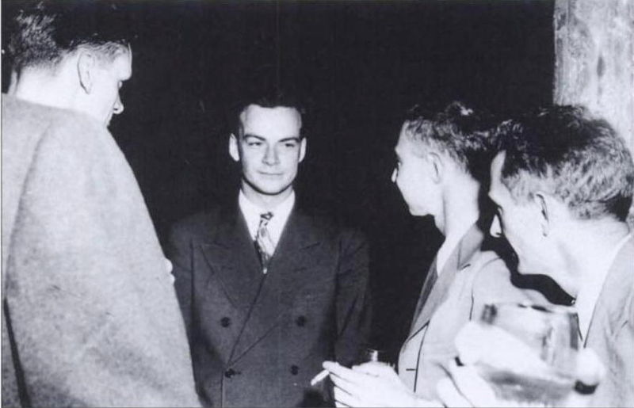
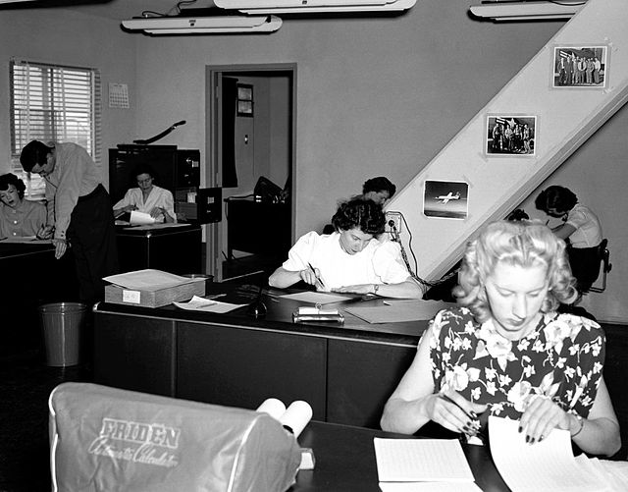
First practice of Human Computer
Teams of people were frequently used to undertake long and often tedious calculations; the work was divided so that this could be done in parallel.
  Richard Feynman: administering the computation group of human computers in the theoretical division in Manhattan project.
    (one of his students there, John G. Kemeny, later went on to co-design and co-specify the programming language Basic).
    Later, with Nicholas Metropolis, he assisted in establishing the system for using IBM punched cards for computation.

Slide 7
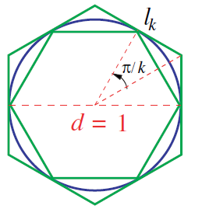
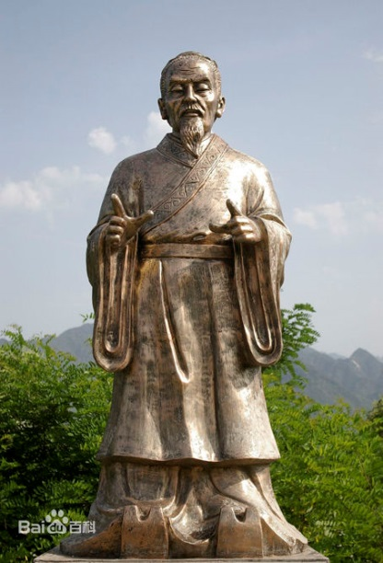
The story of Pi
Archimedes: 250 BC, 3.1408 < π < 3.1429, with a 96 sideded polygon.
Liu Hui: 3.1410 < π < 3.1427, later π 3.1416, with a 3072 sided polygon! (around 265 AD)
Zu Chongzhi and Zu Gengzhi (around 480 AD) : 24 576-sided regular polygons! 3.141 592 6 <π < 3.141 592 7, this record stands for 800 years!
The team led by George Reitwiesner and John von Neumann (1949): achieved 2,037 digits with a calculation that took 70 hours of computer time on the ENIAC computer.

Slide 8
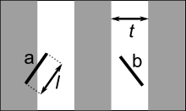

Buffon’s needle
Buffon's needle problem is a question first posed in the 18th century by Georges-Louis Leclerc, Comte de Buffon:
Suppose we have a floor made of parallel strips of wood, each the same width, and we drop a needle onto the floor. What is the probability that the needle will lie across a line between two strips? When l<t,

Slide 9
Experiment of Buffon’s Needle
In 1901, Italian mathematician Mario Lazzarini performed the Buffon's needle experiment. Tossing a needle 3408 times, he obtained the well-known estimate 355/113 for π, which is a very accurate value, differing from π by no more than 3×10⁻⁷. (l/t = 5:6)
That’s a Cheat! Why?
  355/113 = 5/3 · n/x, x = 113n/213
  3408 = 213 · 16

Slide 10
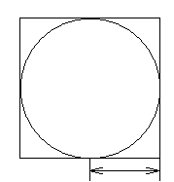
A simple simulation of Pi using Monte Carlo method
Dart game
Algorithm
  Generate a pair of random coordinates (x, y), with -1<x,y<1
  Calculate the distance from the origin to the point.
  Keep the count of the number of darts in circle and number of darts in square.
Pi = 4 x (Number of Darts in Circle) / (Number of Darts in Square)

Slide 11
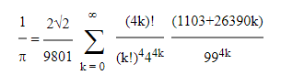
Ramanujan type formulae
An Indian mathematician, Srinivasa Ramanujan (1914)
  published a set of 14 new formulae
  One is very famous:
  Each term adds about 8 digits to the result.
    S. Ramanujan, Modular equations and approximations to p, Quart. J. Pure Appl. Math., (1914)

Slide 12
Record of computation with the Ramanujan like formulae
1985 : Gosper found 17,500,000 decimal digits.
1994 : The Chudnovsky brothers found 4,044,000,000 digits with their formula.
  D. V. Chudnovsky and G. V. Chudnovsky, Approximations and complex multiplication according to Ramanujan, in Ramanujan Revisited, Academic Press Inc., Boston, (1988), p. 375-396 & p. 468-472.
http://numbers.computation.free.fr/Constants/Pi/piramanujan.html

Slide 13
Computation vs. Experiment
What’s the difference between computation and experiment?
Quantum computing, quantum simulation, quantum optics.
Is monte Carlo a simulation or an experiment?

Slide 14

Why is Computer simulation important?
There is no exact analytical solution for a many-body problem！
  only a two-body problem can be solved analytically.
  Other general methods for many-body problems involve approximations with uncontrolled errors！

Slide 15
Why is computer simulation important?
Uncontrolled approximations always breakdown somewhere.
  test out or benchmark, approximate methods
  find their range of validity.
  exactness of simulation is very important!
  otherwise, wasting computer and human time.

Slide 16
Why is computer simulation important?
What is the role of theory today? Why not just measure properties in the lab?
  reliable predictions when experiments are
    not possible or very difficult, or very expensive.
    Some examples: materials phase transitions under extremely high pressure, nuclear reaction, car collision, etc.

Slide 17
Why is computer simulation important?
Interesting to study artificial models to gain insight into the limitations of theory.
  For example: how do phase transitions change in going from 2 to 3 to 4 dimensions?

Slide 18
Why is computer simulation important?
easy to do, even for very complex systems;
their complexity is no worse than the complexity of the physical description.
  purely theoretical approaches typically are applicable only to very simplified models.
  Simulations are good for learning about a system and to get a good idea of what is going on.
  Also they are a good black box for non-experts since one does not have to master a particular theory to understand the input and output of a simulation.

Slide 19
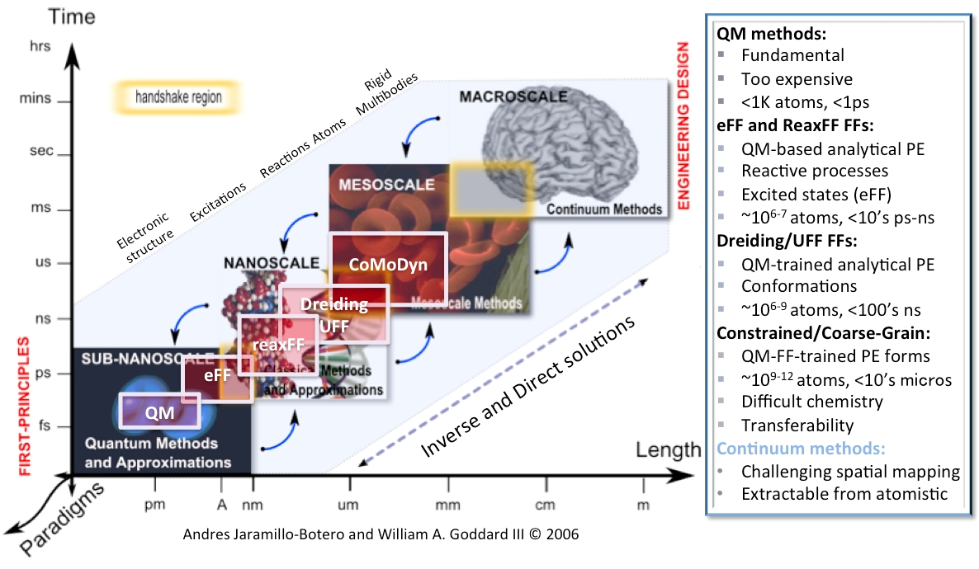
Why is computer simulation important?
Simulations scale up with the increase of computer power. The earliest simulations involved 32 particles; now one can do millions of particles (or more!).

Slide 20
Why is computer simulation important?
A third way of doing science, comparable to theory and experiment.
Simulations do have both theoretical and experimental aspects.
Simulations have become so important that all scientists should learn its fundamentals.

Slide 21
Why is computer simulation important?
Many applied applications even outside of physical science!
  for example, simulated annealing for optimization,
  simulations of world wide web and internet,
  simulations of finance.
The literature on simulation is quickly expanding but comprehensive textbooks are non-existent.
  many interesting techniques have not yet been invented or tried.
  The rapid pace of hardware developments => a lot of problems can be solved with brutal force techniques => less development of clever methods
plenty of opportunities for students to make important advancements.

Slide 22
Computer Simulation vs. Computer modeling
Simulation:
  Assume:
    the Hamiltonian is given from experiment (for example the non-relativistic Schrodinger equation with coulomb interactions).
    Most of the basic equations in condensed matter physics are all well-known.
    It is just a question of working out the details.
    What properties of a many-body system can we calculate without making any uncontrolled approximations?
    A simulation expert is essentially an applied mathematician?
    No!
    physics knowledge and intuition to figure out which simulations to do, which properties to measure etc.,
    just like an experimentalist needs to do more than read the output of the apparatus.

Slide 23

Computer Simulation vs. Computer modeling
Modeling:
  allowed to invent new equations and algorithms to describe some physical system.
  Invent a fictitious model with some dynamics that is easy to do on a computer and do systematic studies of the properties of the model.
  might investigate whether some physical systems are described by the model.
  Clearly this approach is warranted in such fields as economics, ecology, biology ...
  since the "correct" underlying description has not always been worked out…
Simulation or modeling?
  The movie “The Matrix”
  Are we in a simulation or modeling?

Slide 24
Important things in this course
The theoretical (mathematical) underpinnings of simulation.
  We must understand all the approximations and errors since we want to control all of the errors.
  The generic problems with simulations.
    The fundamental problem: computer time is limited!
    The number of particles and the total length of the simulation are much smaller and shorter than the real world.
    All simulation results have statistical errors.
      We have to be able to control the effects of these limitations.
  What is the optimal algorithm for a given problem?
  How do we measure the performance of an algorithm?
    Important problems take a great deal of computer resources
    optimization is important!
      In the past, the efficiency of simulations has increased more because of better algorithms than computer hardware.

Slide 25
Important things in this course
Analysis of results.
  All simulations produce are numbers.
  Usual theory produces equations.
  How do we go from numbers to "understandings" ?

Slide 26
Important things in this course
Programming and debugging techniques. How do we gain confidence that the computer code is correct: it is doing what we think it should be doing?

Slide 27
Important things in this course
Research aspects. We will not treat a code as a black box. We will attempt to explain the logic behind why things are done in a particular way.
In the class project you will be writing pieces of code. This is the way to understand how it all works and how to do research in the field.

Slide 28
Important things in this course
What are the outstanding challenges?
Which properties can't we simulate?
Classical simulations of simple properties are in relatively good shape unless you have a system that requires many particles or long time scales. (For example, the propagation of a crack, the movements of proteins etc.)
Quantum systems (correct theory for microscopic phenomena) are much harder!

Slide 29
Course contents
Basic Numeric methods: briefly reviewed: Interpolations and approximations. Differentiation and integration. Zeros and extrema of a single-variable function.
Numerical methods in linear algebra：Briefly reviewed: Matrices in physics, basic matrix operations, linear equation systems, eigenvalue problems.

Slide 30
Course contents
Main topic and project. Ordinary differential equations in physics, e.g. Newton's equation of motion. Atomic scale simulation, optimization of the structure.
  Main programming project.
Briefly discussed: Partial differential equations in physics, e.g., diffusion, and Molecular dynamics, Machine learning, Density functional theory, parallel computing.
  Lab tour.
Second major topic and project: Sampling and integration. Applications in random systems, e.g. island nucleation

Slide 31
Course Contents
7 computational laboratories (3 hours each) for two programming projects
  Project A: Atomistic scale simulations: (1) simulation cell (2) reciprocal lattice and neighbor list, periodic boundary conditions (3) potentials (4) optimization
  (5) Demonstration of Machine learning.
  Project B: (6) Monte Carlo method.
  (7) Understanding parallel computing.
  Science Centre 326

Slide 32
Assessment Scheme
 | Component | Description | Weight
 | Homework | The homework will be graded by the TA and the graded homework will be returned to you. If you have enquiries concerning the grading, please feel free to contact me or the TAs. | 10%
 | Project A | Individual project. Including the program, outputs. | 40%
 | Project B and presentation | Individual project. Including program, outputs, in-class presentation, and a report | 35%
 | class presentation Class activity | one topic in computational physics Answering important questions, pointing out errors in lectures, class attendance. | 10% 5%

Slide 33
Reference books
1 | Computational physics. K. H. Hoffmann and M. Schreiber | QC32 .C65 1996
2 | Tao Pang, “An Introduction to Computational Physics”, Cambridge University Press, New York, 1997 | QC20.7.E4 P36 1997
3 | Richard Martin. Electronic Structure Basic Theory and Practical Methods. | QC176.8.E4 M368 2004

